Slide 1



Intermediate
Programming
WEEK 7 – Classes and Objects

Slide 2
Outline
Object Oriented Programming (OOP)
Classes and Objects
Parts of a class

Slide 3
What is OOP?
OOP (Object oriented programming) is about creating objects that contain both data and methods. Java is an example of an OOP language.

Slide 4
Advantages of OOP
OOP is faster and easier to execute
OOP provides a clear structure for the programs
OOP helps to keep the Java code DRY "Don't Repeat Yourself", and makes the code easier to maintain, modify and debug
OOP makes it possible to create full reusable applications with less code and shorter development time

Slide 5
DEMO

Slide 6


Classes and Objects
Class is a user defined blueprint or prototype from which objects are created. It represents the set of properties or methods that are common to all objects of one type.
Objects are instances of class.
Classes are categories, and objects are items within each category.
ANIMAL
(Class)
Objects

Slide 7
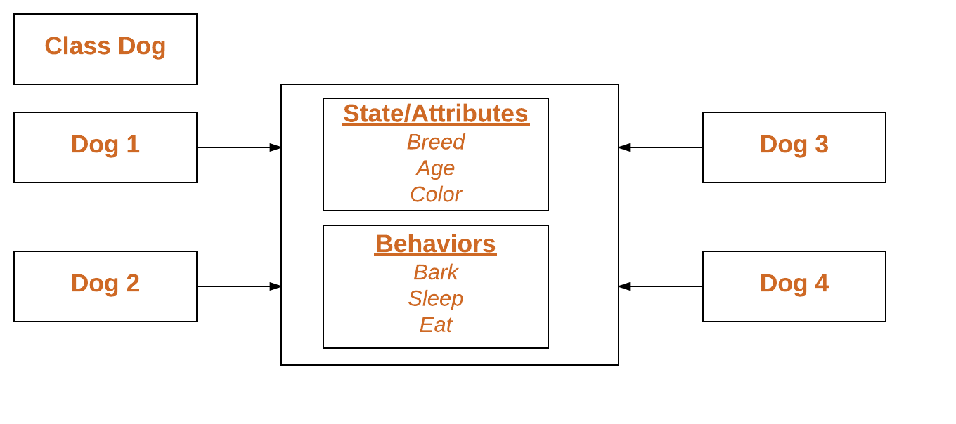
Objects
State (Variables): It is represented by attributes of an object. It also reflects the properties of an object.
Behavior (Methods): It is represented by methods of an object. It also reflects the response of an object with other objects.
Identity (Identifier): It gives a unique name to an object and enables one object to interact with other objects.

Slide 8
DEMO

Slide 9
Intermediate
Programming
WEEK 7 – Classes and Objects

